Slide 1


BESTEM’20 UBISOFT
CARD GAME CHALLENGE

Slide 2

1. GAME RULES
2. DEFINITIONS
3. HEROES & DECK BUILDER
4. ROUND PHASES
5. ATTACK PHASE
6. LEADERBOARD
7. ADVANCED GAMEPLAY

Slide 3
1. GAME RULES

Slide 4

GAME RULES
Minimum required rules:
Every player should be able to select a hero
Define the number of cards that decks should contain and max number of same card that can be included
Define a minimum of 10 types of creatures
Choose game type with mana cards or with automatically increased mana
Define game end rules (e.g. hero health, empty deck)

Slide 5
2. DEFINITIONS

Slide 6
DEFINITIONS
CARD ANATOMY
Name
Mana cost – mana is the resource used to cast creatures
Type line – every card has a type, for MVP we will use only creature type and mana card type
Text box – some cards can have abilities, for the MVP this will be empty
Power/Toughness – every creature card type should have to values representing these abilities

Slide 7
DEFINITIONS
GAMEBOARD
Deck – a face down pile with all the selected cards
Hand – a player has a starting hand of X cards, at the end of the turn that player cannot have more than X
Battlefield – both players shares battlefield, mana, creatures, equipment’s are played here
Discard pile – creatures that die, discarded cards go here. Every player has his own graveyard

Slide 8
DEFINITIONS
GAME ACTIONS
Tapping and Untapping – to tap a card is to turn it sideways to show that it has been used for the turn. A card cannot be tapped again until it’s been untapped. Cards are untapped at the start of a turn only for the current player
Casting Creatures – to cast a creature you should pay mana cost of the creatures by tapping mana cards or by decreasing mana counter
Casting mana – a player can cast for free a mana card per turn

Slide 9
3.HEROES & DECK BUILDER

Slide 10
HEROES & DECK BUILDER
HEROES
Define 4+ different heroes that can be selected at the start of the game
Define 1 ability per hero that can be used once per round
DECK BUILDER
Define minimum 10 types of creatures
Add ability to create a deck of X cards choosing from existing library of cards. A card cannot be added more than X times defined in the rules.
Add possibility to save the deck under player profile

Slide 11
4.ROUND PHASES

Slide 12
ROUND PHASES
START PHASE
Untap cards, increment mana if it’s automatic
DRAW PHASE
Draw 1 card
PLAY CARDS 1
Play mana/creatures cards
ATTACK PHASE
Choose creatures that will attack, choose defenders, resolve attack
PLAY CARDS 2
Play mana/creatures cards
CLEANUP PHASE
Discard cards to hand limit

Slide 13
5. ATTACK PHASE

Slide 14
ATTACK PHASE
A creature that entered the game in the current round cannot attack.
Steps:
Declare attackers – tap those creature cards
Declare defenders – defender chose who blocks who
Resolve damage
An attacking creature that isn’t blocked deals damage to the player it’s attacking.
An attacking creature that is blocked deals damage to the creature or creatures that are blocking it, and vice versa
If damage is dealt to the opponent, they lose that much life.

Slide 15
6. LEADERBOARD

Slide 16
LEADERBOARD
Create an algorithm for leaderboard and a page that will display this ranking system

Slide 17
7. ADVANCED GAMEPLAY

Slide 18
ADVANCED GAMEPLAY
AI
allow AI players
automatically create deck, choosing some types: aggressive, action oriented deck, etc.
MANA
different type of mana colors
HEROES
define more attributes / abilities for a hero (suggestions below)
defense (passive) - reduces the lost HPs when attacked
raise attack value for 1 / all tapped cards (activate ability, consumes mana)
skip turn increases defense for one round

Slide 19
ADVANCED GAMEPLAY
CREATURE - STATIC/PASSIVE
flying => a creature with flying can be blocked only by other creature with flying or reach
taunt, defend => you cannot attack another creature on the battlefield until you destroy the taunter/defender
first strike => the creature with first strike assign damage first
flash => a creature with flash can be played also on the opponent turn
haste => a creature can attack on the same turn they enter the battlefield
life link => a creature with life link, gain life for its owner equal with his attack power if it's used in combat
reach => a creature with reach can block creatures with flying
Vigilance => a creature with vigilance it's not tapped on attack phase
Hexproof => a creature with hexproof cannot be target of direct-action cards(target creature), but can be affected by global actions
creature attack has a 50% of stunning the attacked creature (cannot attack for one round)

Slide 20
ADVANCED GAMEPLAY
CREATURE – ACTIVATED ABILITIES
tap this creature to give flying to 1/all your other creatures
tap this creature to give 1 damage to 1/all opponent creatures
ACTION CARDS
deal x damage to target opponent
deal x damage to target creature, or general deal x damage to all creatures
tap target creature
give some ability to target creature for this round
destroy target equipment
cancel target action
draw x cards
EQUIPMENT CARDS
equipped creature have +x attack and defense
equipped creature has flying ability

Slide 21
Q&A

Slide 22
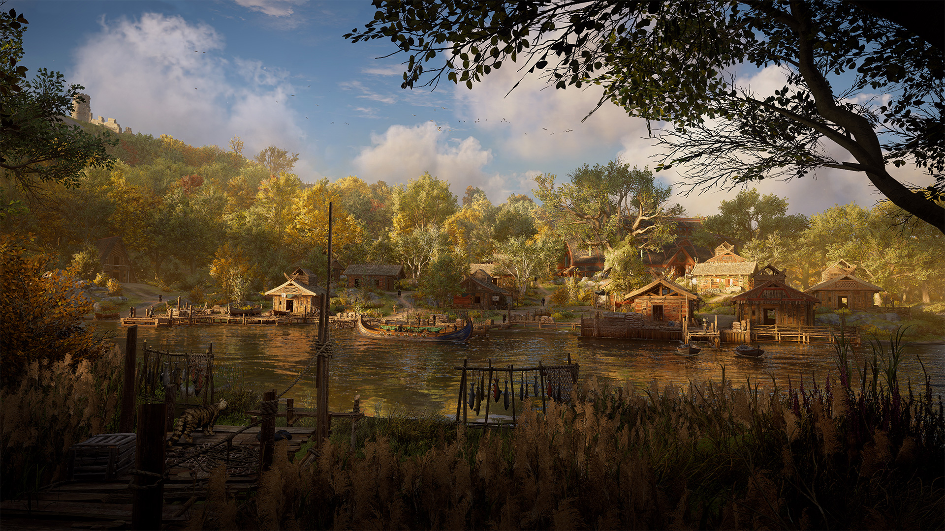

Thank you!

